Slide 1
Classification of Etsy and shopify POST
Project 3 prepared by Meng chin

Slide 2

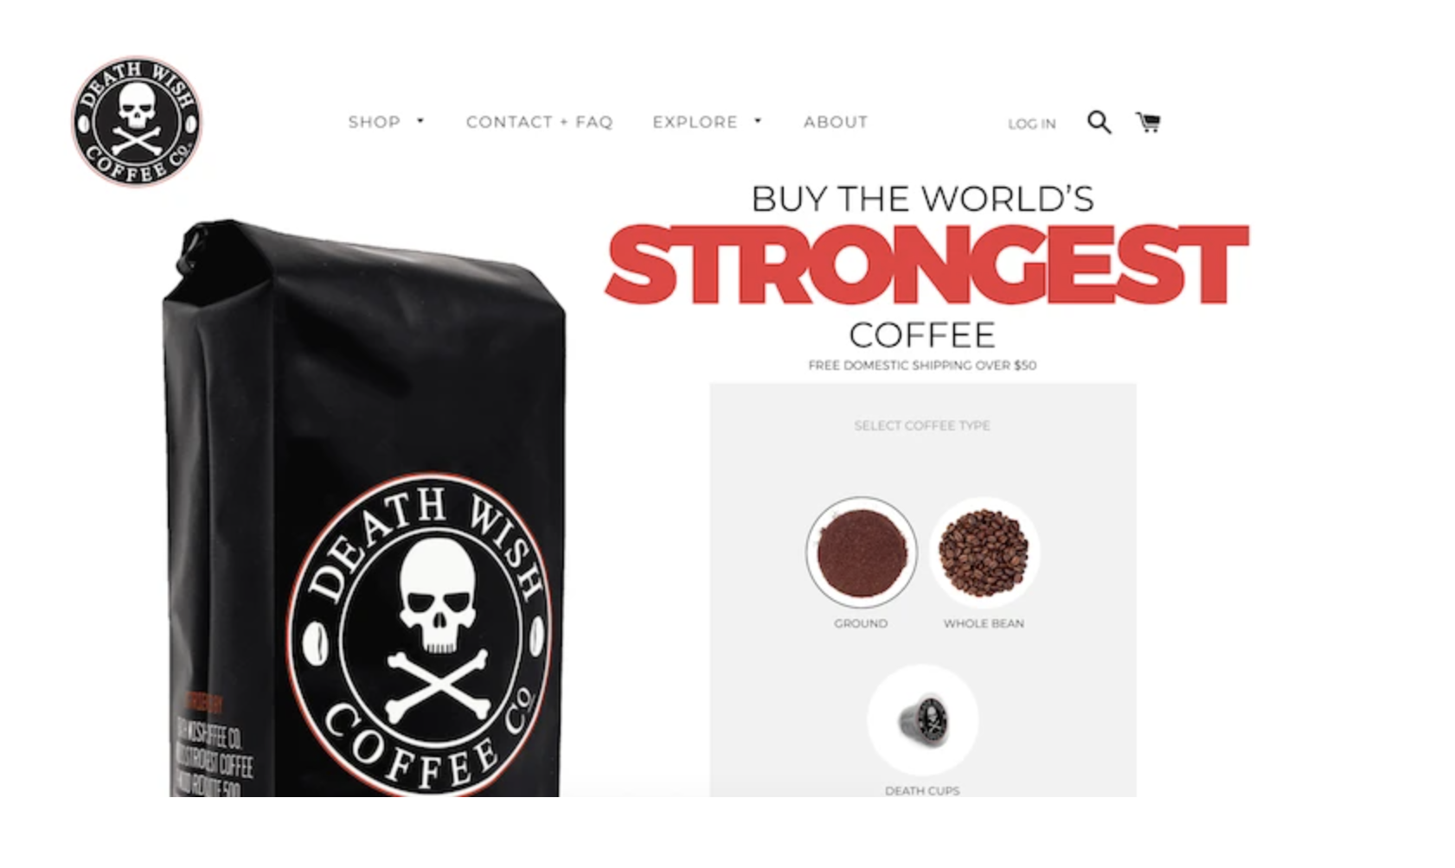

Slide 3
Problem Statement
Create a classification model to help effectively categorize the sub-reddit post for Etsy and Shopify and discover what are the main differences to help small businesses select the most effective platform for themselves.
To understand the main focus of our client so as to effectively channel our market strategies to increase Etsy market share.

Slide 4
Pre-Processing
Dropped duplicated posts
Joined title and post
Removed all punctuation
Convert all to lowercase
Lemmatized words
Removed stop words

Slide 5
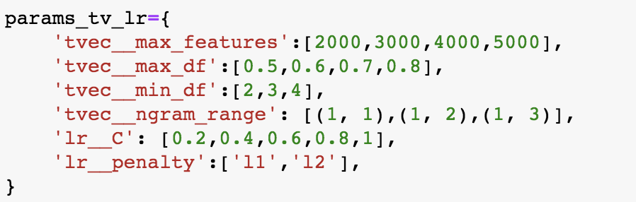
Modelling and GRIDSEarCH
Count Vectorizer vs TF-IDF Vectorizer
Logistic Regression vs Multinomial Naïve Bayes

Slide 6
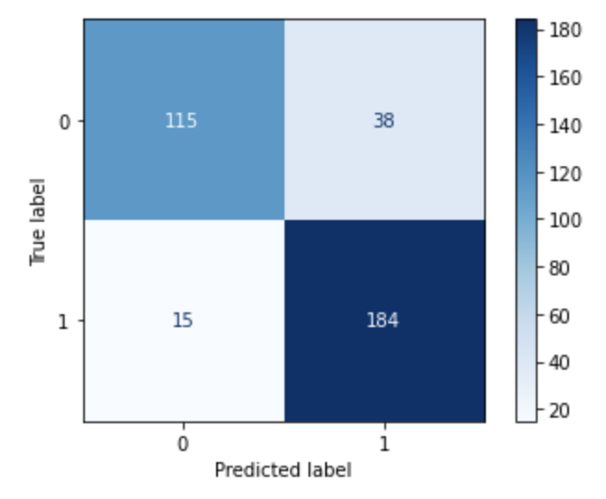
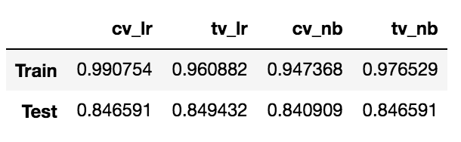
Evaluations of predicted results

Slide 7
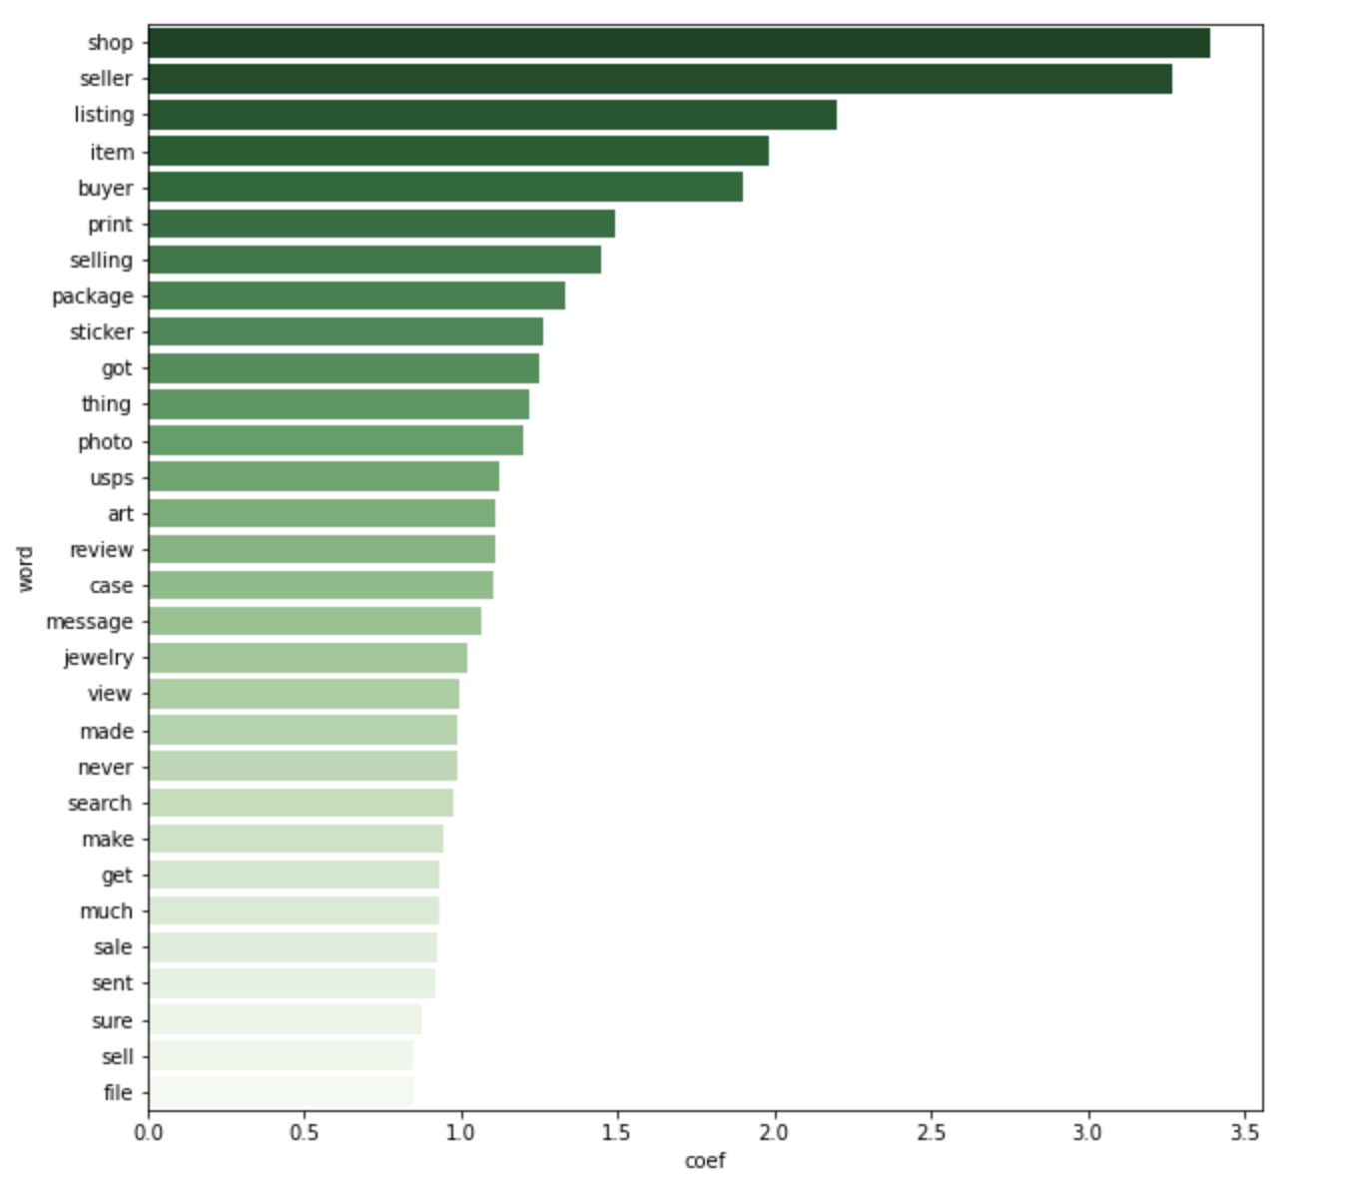
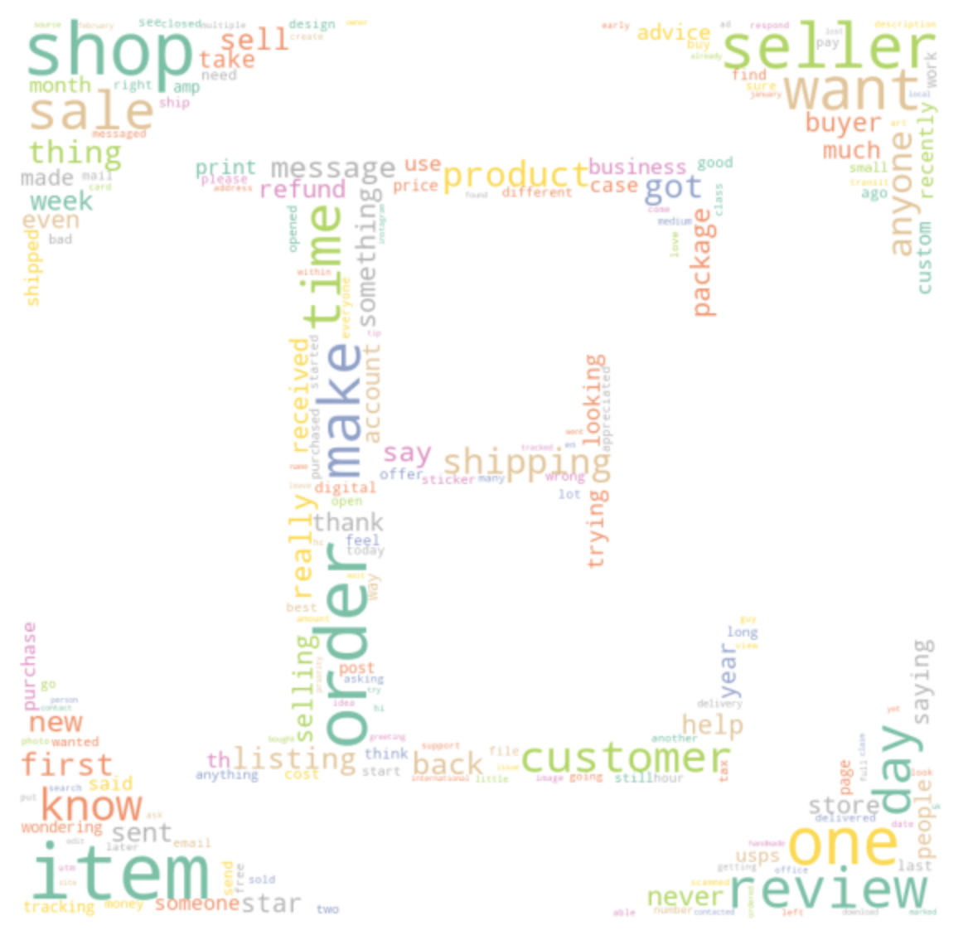
Etsy Impactful Word(s)

Slide 8
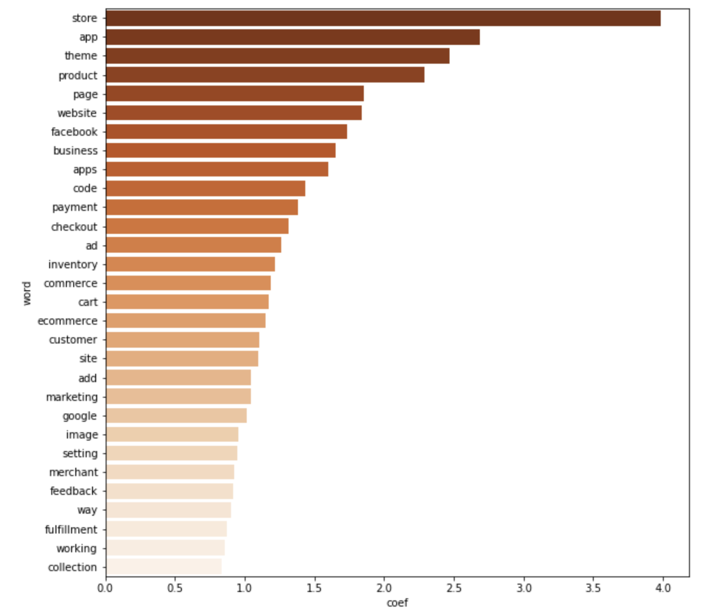
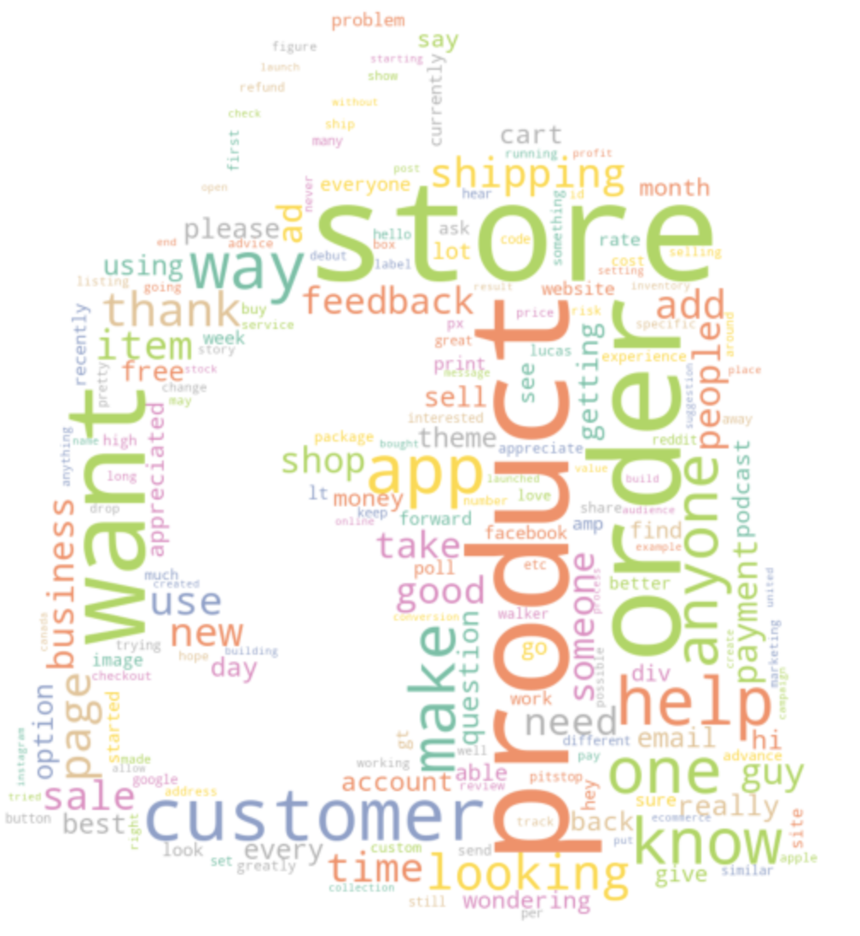
Shopify Impactful Word(s)

Slide 9
Conclusion and Recommendation
To provide publicity for our client listed product
To provide an effective channel for buyers to request customized product
Improving user experience

Slide 10
Thank you

